Slide 1

CSE3251
Computer Networks
Dr. Asif Zaman
Professor, CSE, RU

Slide 2
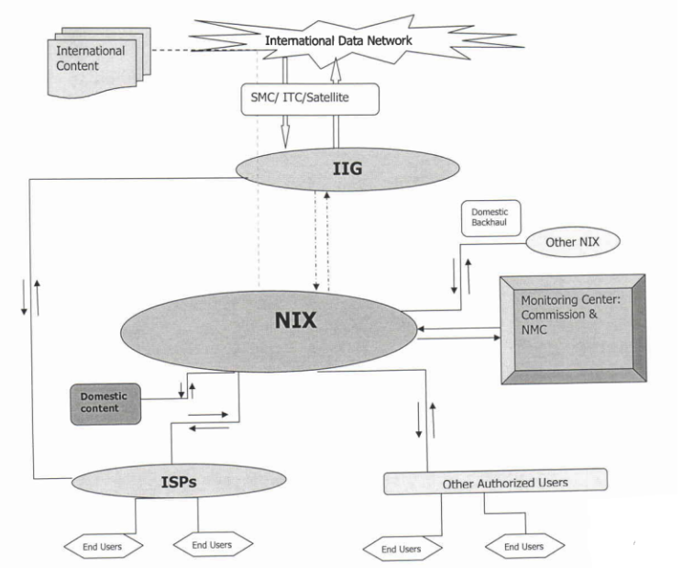

Slide 3
Fundamental Idea
Network Card (LAN Card)
Network Card (LAN Card)

Slide 4
Fundamental Idea
HUB/ SWITCH
Protocol

Slide 5
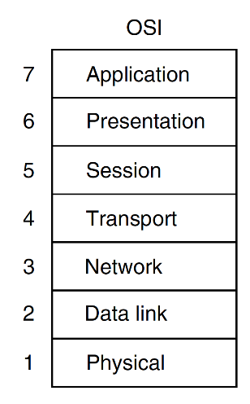
Introduction
All People Seem To Need Data Processing
Open Systems Interconnection
International Organization for Standardization(ISO)

Slide 6
RJ-45 Connector
Hub vs Switch…
Pricing of Switch….
UTP –Unshielded Twisted Pair

Slide 7
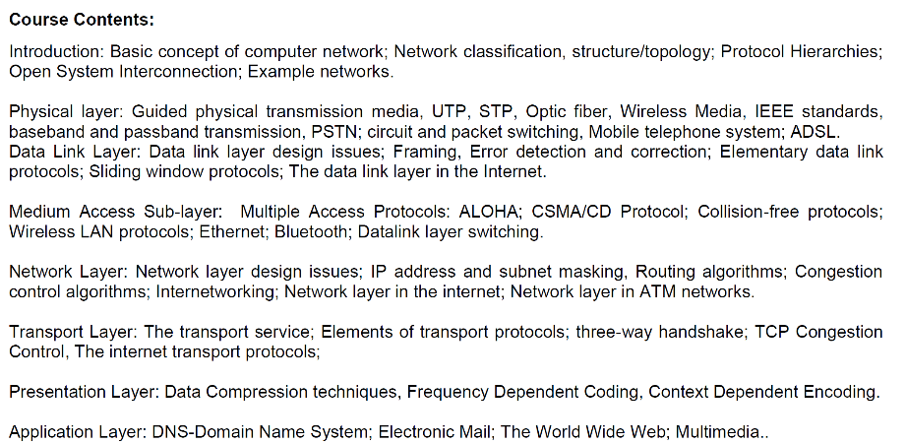

Slide 8
What is Computer Network?
Collection of autonomous computers interconnected by a single technology.
Two computers are said to be interconnected if they are able to exchange information.
The connection need not be via a copper wire; fiber optics, microwaves, infrared, and communication satellites can also be used.

Slide 9
What is a Distributed Systems?
… is an environment where
multiple devices or computers are working on various components and tasks across a network.
The components within distributed systems split up the work, coordinating efforts to complete a given job more efficiently than if only one device ran it

Slide 10
Computer Network vs Distributed Systems
There is considerable confusion in the literature between …
Distributed system… appear as a single system to user.
A distributed system is a software system built on top of a network.

Slide 11
Applications of Computer Network??
Business Applications
Home Applications
Mobile Users
Social Issues

Slide 12
Business Applications
Primary Goal???
Resource sharing:
Share printer, scanner…
more important than sharing physical resources –sharing data
Share customer records…
Two important concept in resource sharing
VPNs (Virtual Private Networks)
Client Server Model:
Web application

Slide 13
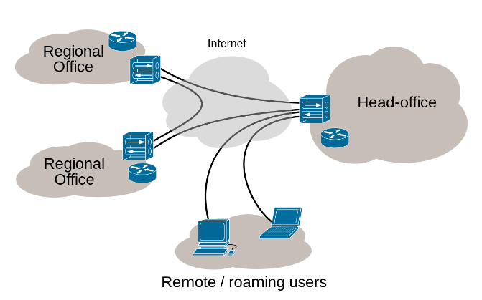
VPNs (Virtual Private Networks)

Slide 14
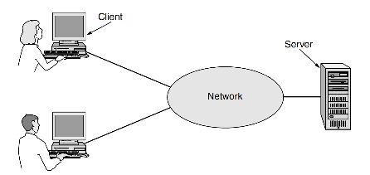
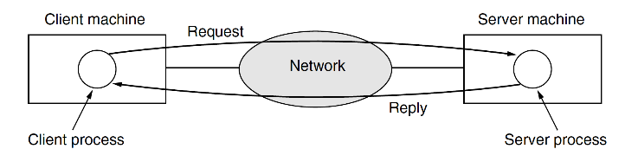
Client Server Model

Slide 15
Business Application
Secondary Goal
Powerful communication medium:
Email, VOIP, video calling
Desktop sharing
TeamViewer, AnyDesk
Tertiary Goal
e-commerce (electronic commerce)

Slide 16
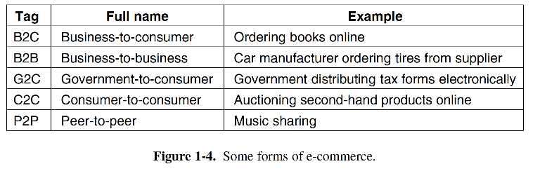
Business Application

Slide 17
Home Application
Connectivity (home users can…)
Connect to remote computers
access information,
communicate with other people, and
buy products and services with e-commerce.
People can surf the net for fun, movie, chatting…
People can surf the net for news portals
People can surf the net for research like IEEE, Springers…
Mainly Client server model but… peer to peer model

Slide 18
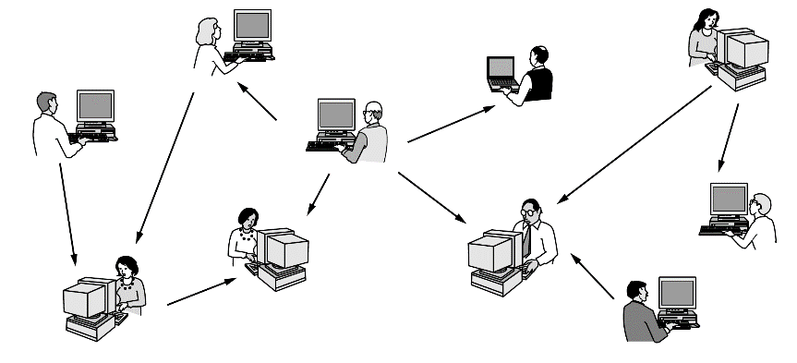
Home Application
Peer to Peer model:
direct contact or exchange between people of similar rank or position.
Peer-to-peer model (BitTorrent (Cohen, 2003))

Slide 19
Home Application
Instant messaging
Twitted, Facebook, WhatsApp
Wikipedia – a group of people creating contents…
E-commerce…

Slide 20
Others
Mobile Users
Connectivity
Mobile hotspot
Texting, sms
GPS
M-commerce
NFC (Near Field Communication)
Social Issues

Slide 21
Transmission Technology
Two types of transmission technology that are in widespread use:
broadcast links &
point-to-point links.

Slide 22
point-to-point links
Point-to-point links connect individual pairs of machines.
…from the source to the destination on
short messages, called packets ….
…one or more intermediate machines.
Often multiple routes, …
..sometimes called unicasting.
Point to point

Slide 23
Broadcast Links
…the communication channel is shared by all the machines on the network;
packets sent by any machine are received by all the others.
An address field within each packet specifies the intended recipient.
… receiving machine checks the address field.
If the packet is intended…
Broadcast

Slide 24
Broadcast + Multicast Links
This mode of operation is called broadcasting.
Some broadcast systems also support transmission to a subset of the machines, which known as multicasting.
Multicast

Slide 25
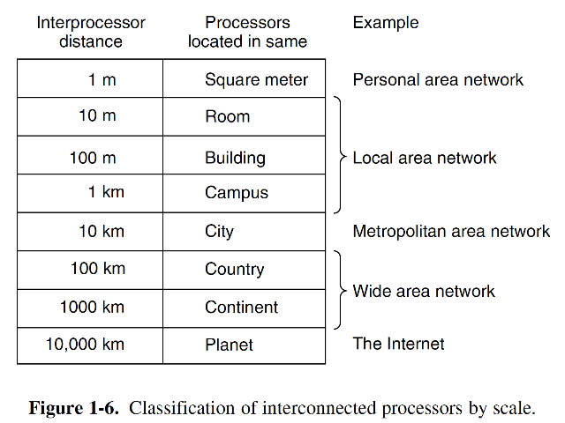
Classify Network By Scale
An alternative criterion for classifying networks is by scale.

Slide 26
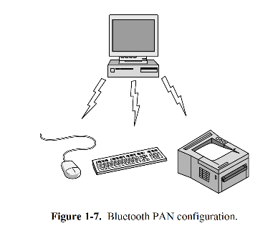
Personal Area Networks
Personal Area Networks
bluetooth

Slide 27
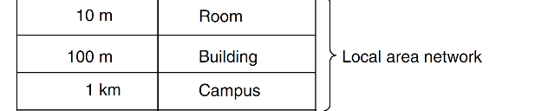
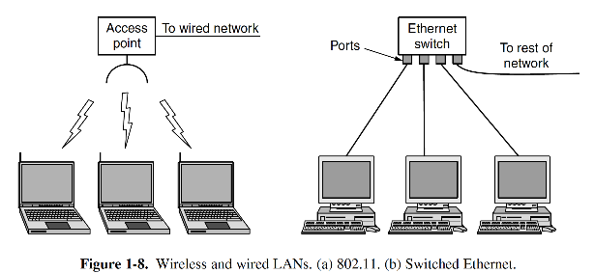
Local Area Networks

Slide 28
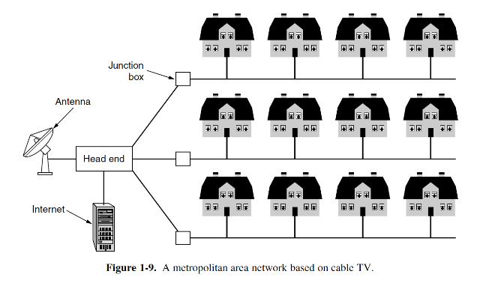
Metropolitan Area Networks
MAN
Cable headed
WiMAX

Slide 29
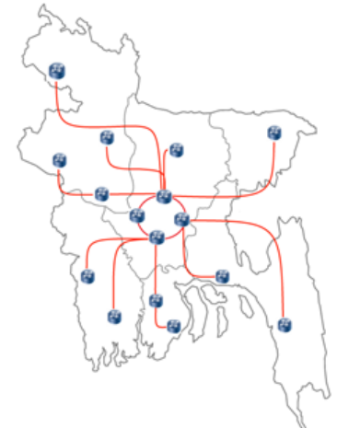
Wide Area Networks
BdRen
WAN

Slide 30
Internetworks
https://www.submarinecablemap.com/

Slide 31
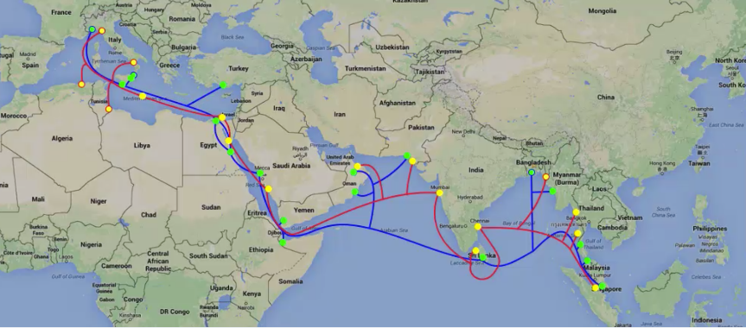
Internetworks

Slide 32
Network Software
The first computer networks were designed with the hardware as the main concern and the software as an afterthought.
This strategy no longer works.
To reduce their design complexity, most networks are organized as a stack of layers or levels, each one built upon the one below it.

Slide 33
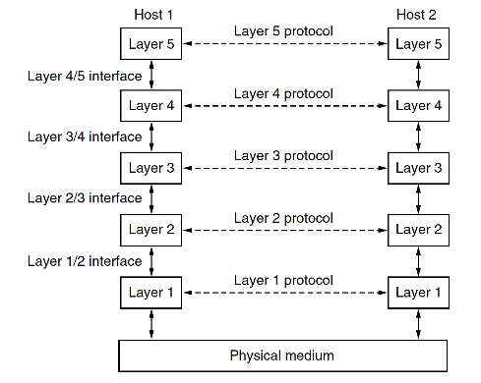
Network Software

Slide 34
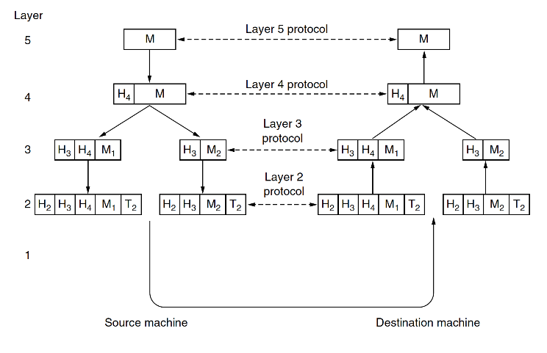
Network Software

